Slide 1

otlin
Youssef Keyrouz

Slide 2
WHY?
Because Google Wants It (Remember eclipse? Me neither)
Official Android Language
Modern Languages (Swift, C# 7)
Created by developers, not corporations
The Community, Support, and JetBrains

Slide 3
How?
Install Kotlin plugin for Android studio < 3.0 (Bundled in 3.0+)
You’re done
Optional: Use Kotlin Folder Source instead of Java

Slide 4
Existing Projects
Kotlin works with java naturally (And vice-versa)
Convert Java Class to KT Classes using:
Menu -> Code -> Convert Java File to Kotlin File
ctrl+alt+shift+K on Window
command+option+shift+K on Mac
Convert entire projects in 1 click (Good luck fixing that)

Slide 5
Quick Word About Expression
Expressions are a piece of code that gets evaluated as 1 final value
a+b
{
Print(“Hello”)
“test”
}

Slide 6
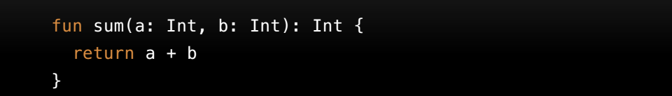
Functions – Basics
Syntax
With Expression Body

Slide 7
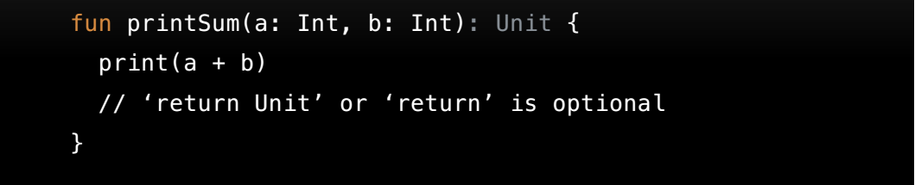
Functions – Unit
Unit is a type with only one value – Unit
Used mostly in generics and function params
Functions can now be used as params

Slide 8
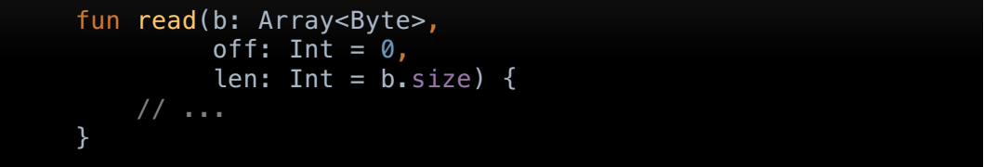
Functions – Default Arguments
Used when function parameter is omitted
Parameters can be used as defaults for other params

Slide 9
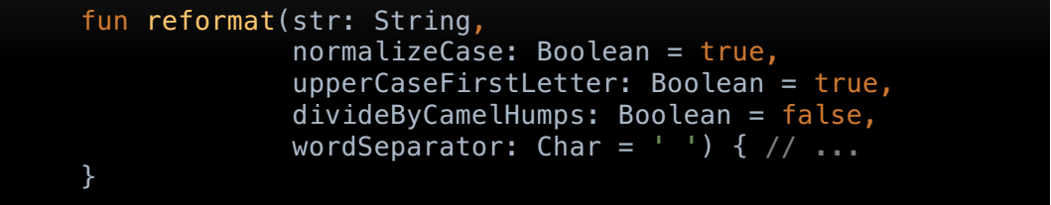

Functions – Named Arguments
Function parameters can be named when called

Slide 10
Functions – Scope
See Example 1 -> Functions

Slide 11
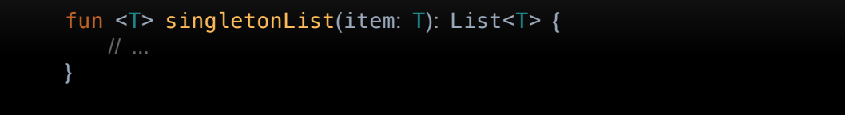
Functions – Generic
Generic Parameters
Type parameters are placed before the function name
To call a generic function:

Slide 12

Functions – Inline
Functions in Kotlin are objects, so consume heap memory at runtime
To minimize GC, we can choose to inline the function
The compiler will inline code into the call site, instead of creating a function object
Tradeoff is bigger generated code

Slide 13
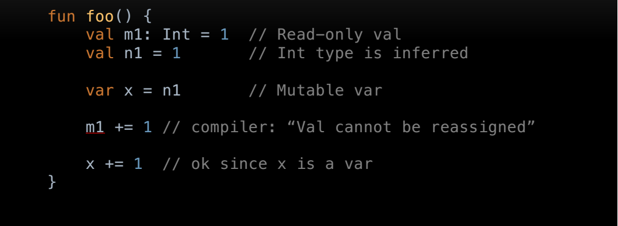
Variables - Defining
Function Params are always val

Slide 14
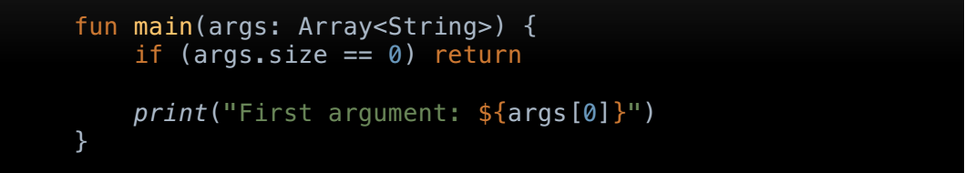
String Templates
Starts with dollar sign $
Piece of code that is evaluated, result is concatenated into the string
Can use simple var e.g. “First Name = $username”

Slide 15
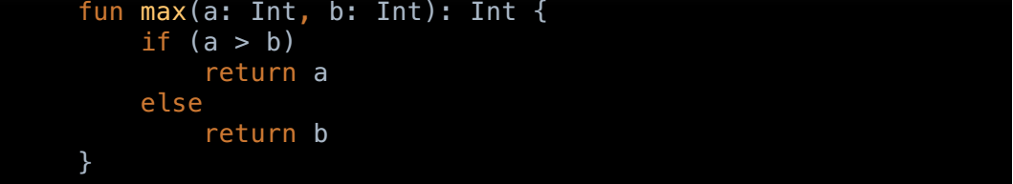
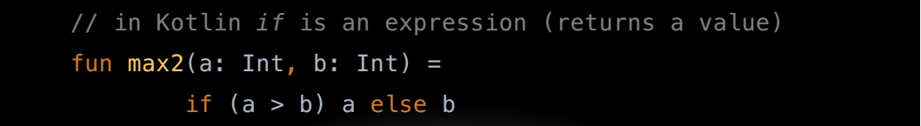
Conditional Expressions
As a statement
As an expression (replaces the ? Operator)

Slide 16
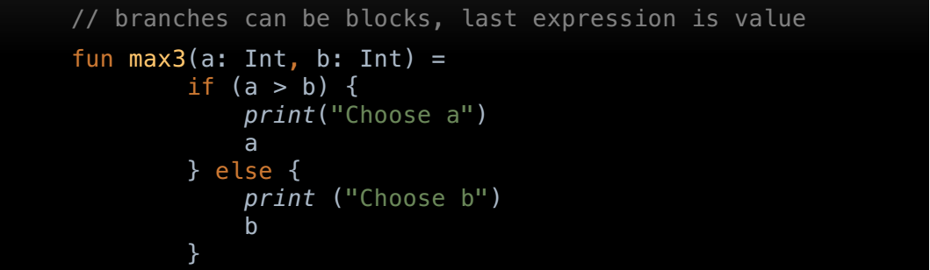
Conditional Expressions
Using if as an expression, rather than as a statement requires that there be an else branch

Slide 17
Nullable Types
Aim is: eliminate NullPointerException when running code
See Example 2 -> NullableTypes

Slide 18
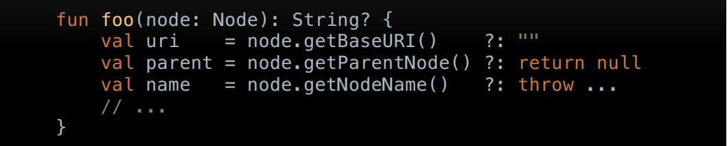
Elvis Operator
Used to specify default value in case of null

Slide 19
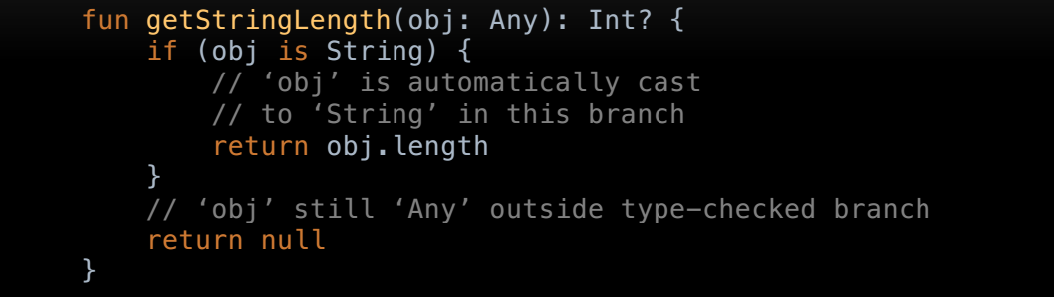
Casting with “is”
Smart Casting
Don’t work when compiler cannot guarantee that there is no change between the check and the usage

Slide 20
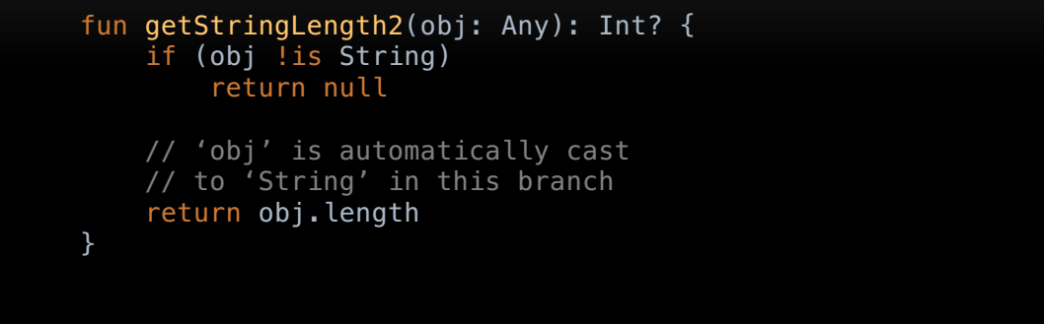
Casting with “is”

Slide 21
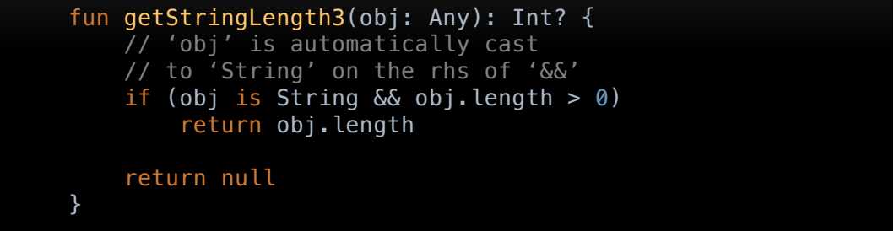
Casting with “is”
Notes:
Will this work with OR?

Slide 22
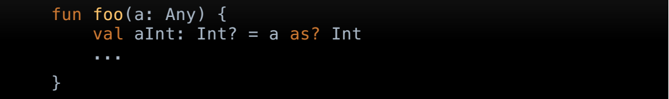
Safe Cast Operator “as?”
aInt is null if casting failed for any reason
Notes:
What’s the return type of Foo?

Slide 23
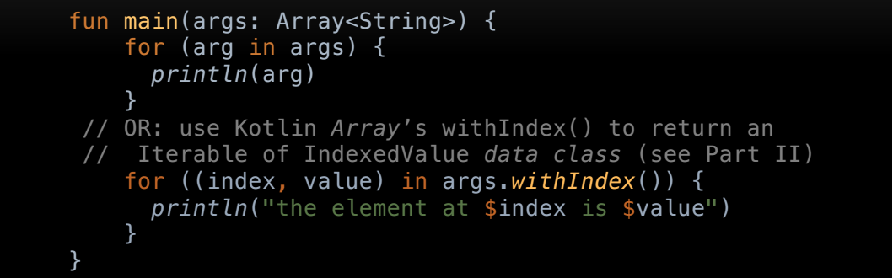
Loops - for
“for” loop iterates through anything that provides an iterator function need to have member-functions next() and hasNext()

Slide 24
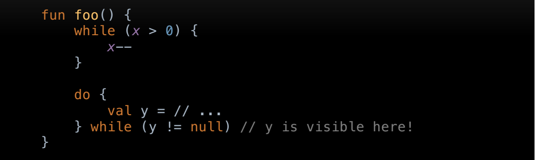
Loops - while
Tip: Smart unwrap and autocast works with while loops

Slide 25
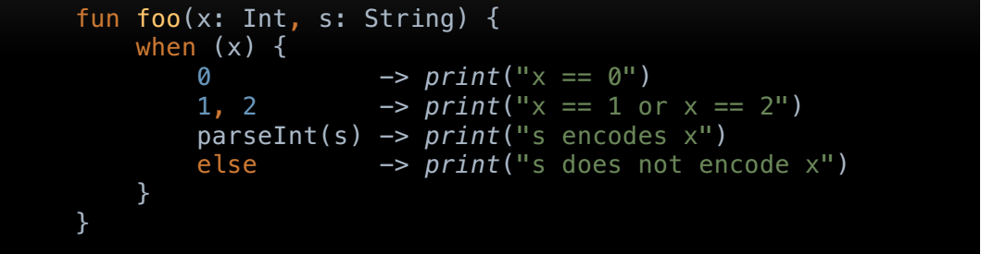
when
Can use expressions

Slide 26
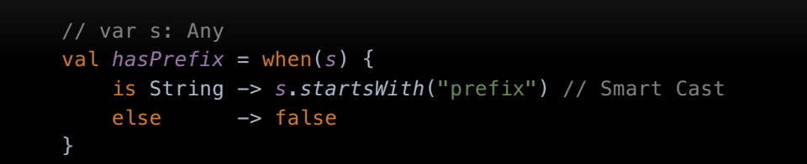
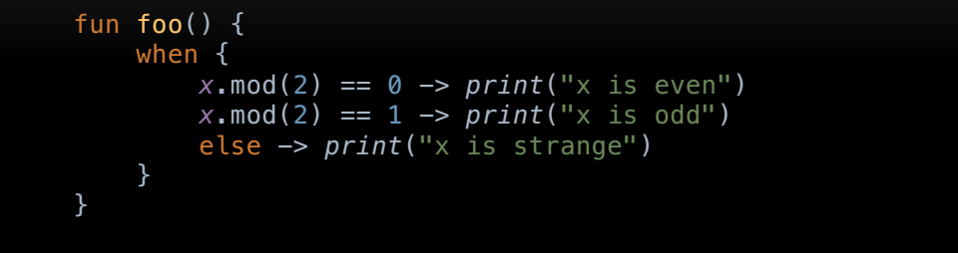
when

Slide 27
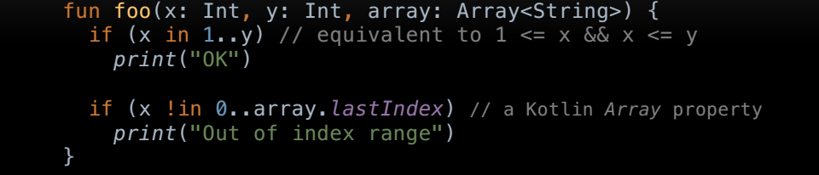
Ranges
Range expressions formed with rangeTo function or its operator form ..
Defined for any Comparable type, but implementation is optimized for integral primitive types

Slide 28
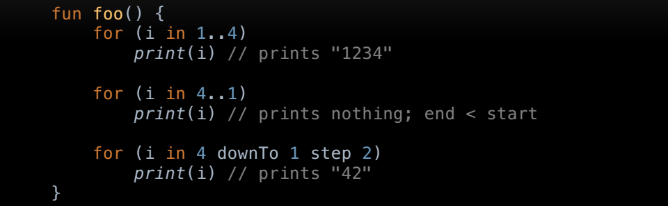
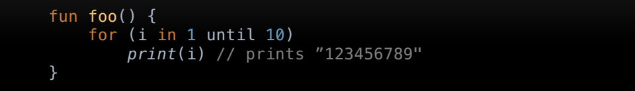
Ranges

Slide 29
Classes
See Example 23 -> ClassesExamples

Slide 30
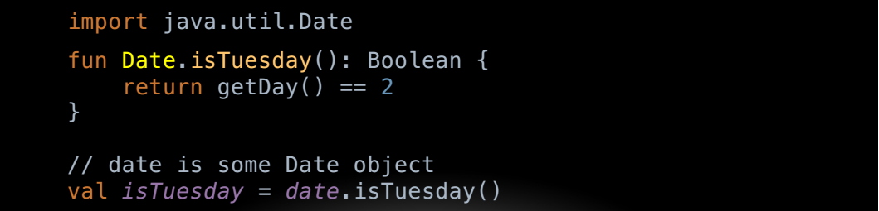
Extensions
Kotlin, similar to C# and Swift, can extend a class with new functionality (instead of inheritance)

Slide 31
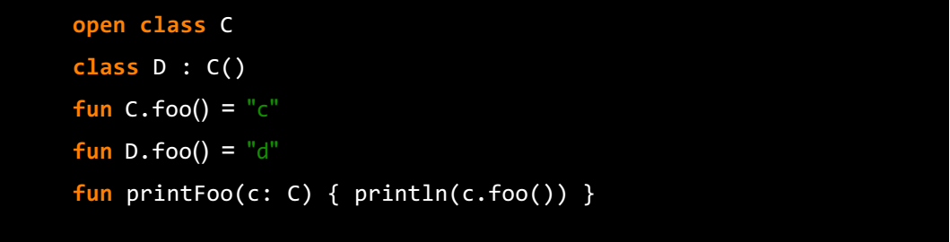

Extensions
Extensions are resolved STATICALLY (resolved bases on the class not the object)
What result will I get if I call

Slide 32
Extensions - Examples

Slide 33
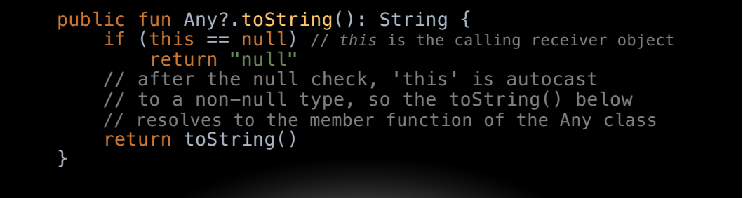
Extensions - Examples

Slide 34
Data Classes
Helper class, used only to hold data
Automatically implement the “equals()”, “copy()”, and “componentN()” functions.
ComponentN used for reflection, or some rare serialization scenarios

Slide 35

QUESTIONS?
https://github.com/YoussefKeyrouz/Presentation-Kotlin.git
Youssef Keyrouz

